Slide 1
Dimensions of Rich Context
… a demonstrator based on Dimensions data and links

Slide 2

Datasets… in a vacuum
Datasets
Notes:
Last updated: January 2019

Slide 3

Making a key connection…
Datasets
98m
Publications improved metadata
of 65m
Notes:
Last updated: January 2019

Slide 4
… more context
Datasets
98m
Publications improved metadata
of 65m
1.1bn links
Notes:
Last updated: January 2019

Slide 5

… who’s paying for this stuff anyway?
Datasets
98m
Publications improved metadata
of 65m
1.1bn links
11m lins 17m to funders
4.3m
Grants
$1.3 trillion in funding
Notes:
Last updated: January 2019

Slide 6



… if we can connect to one, we can connect to all
Datasets
778k links
98m
Publications improved metadata
of 65m
445k
Clinical trials
428k links
9.6m links
1.1bn links
94m
Altmetric data
points
9.2m links
38m
Patents
11m links 17m to funders
777k links
21k links
599k to funders
167k links
222k to funders
320m links
4.3m
Grants
$1.3 trillion in funding
385k
Policy documents
Notes:
Last updated: January 2019

Slide 7
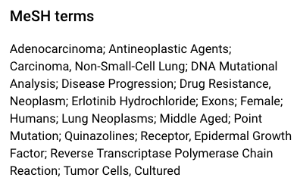
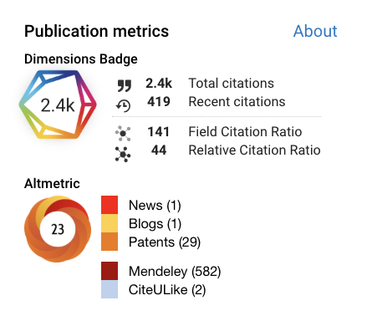
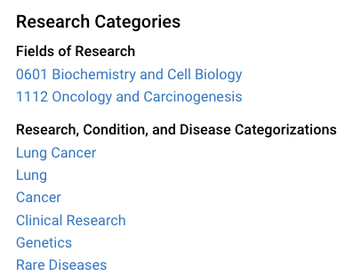

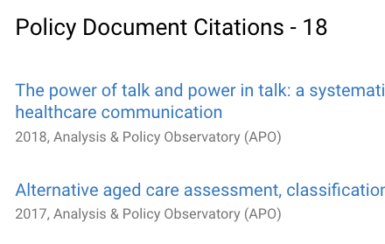
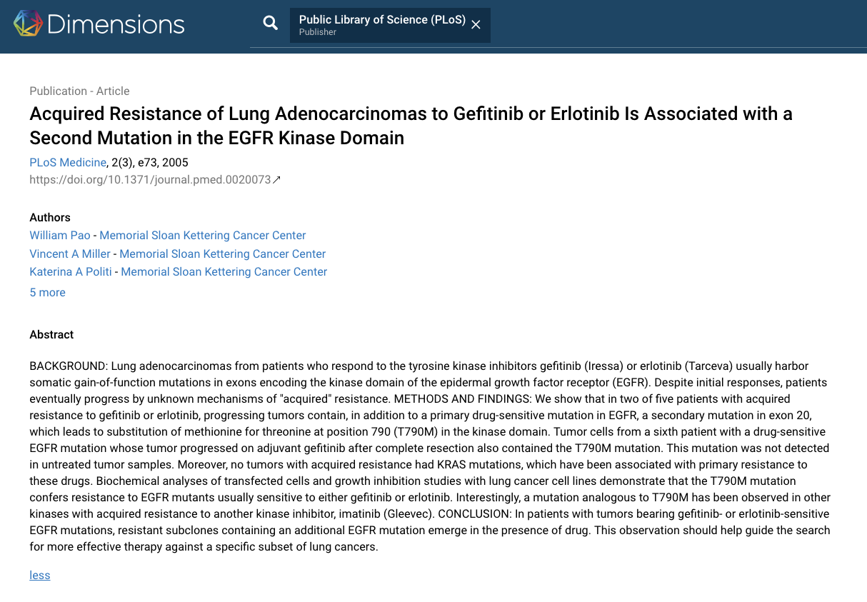
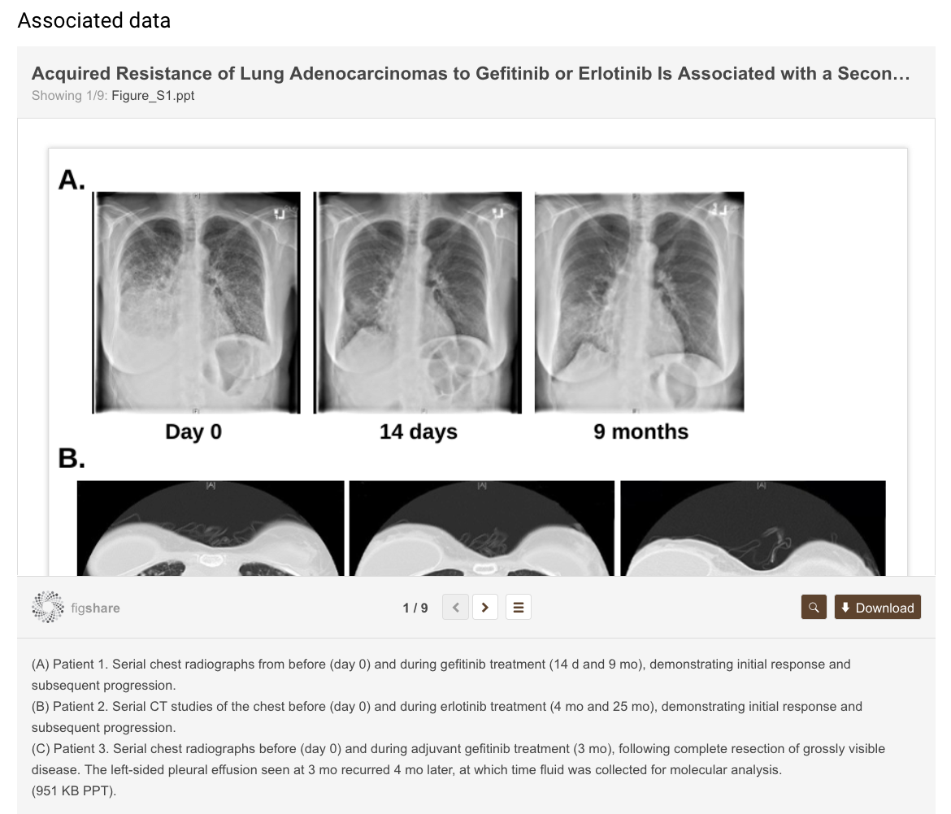
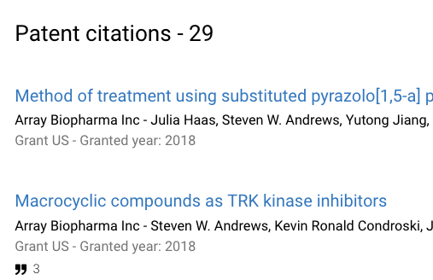
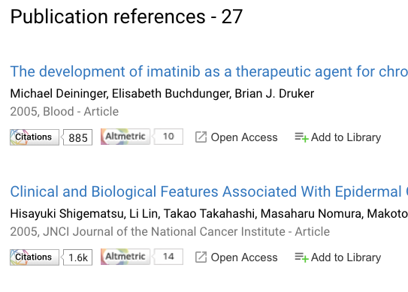
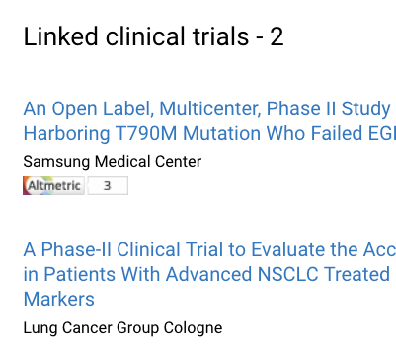
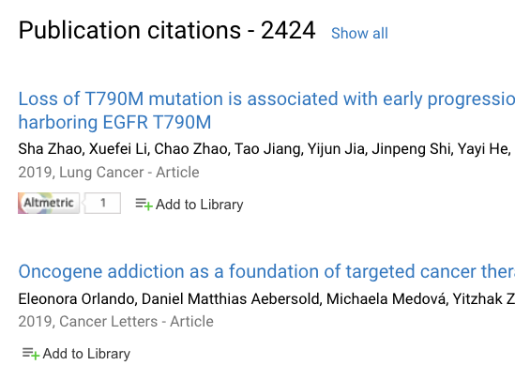

Context!

Slide 8
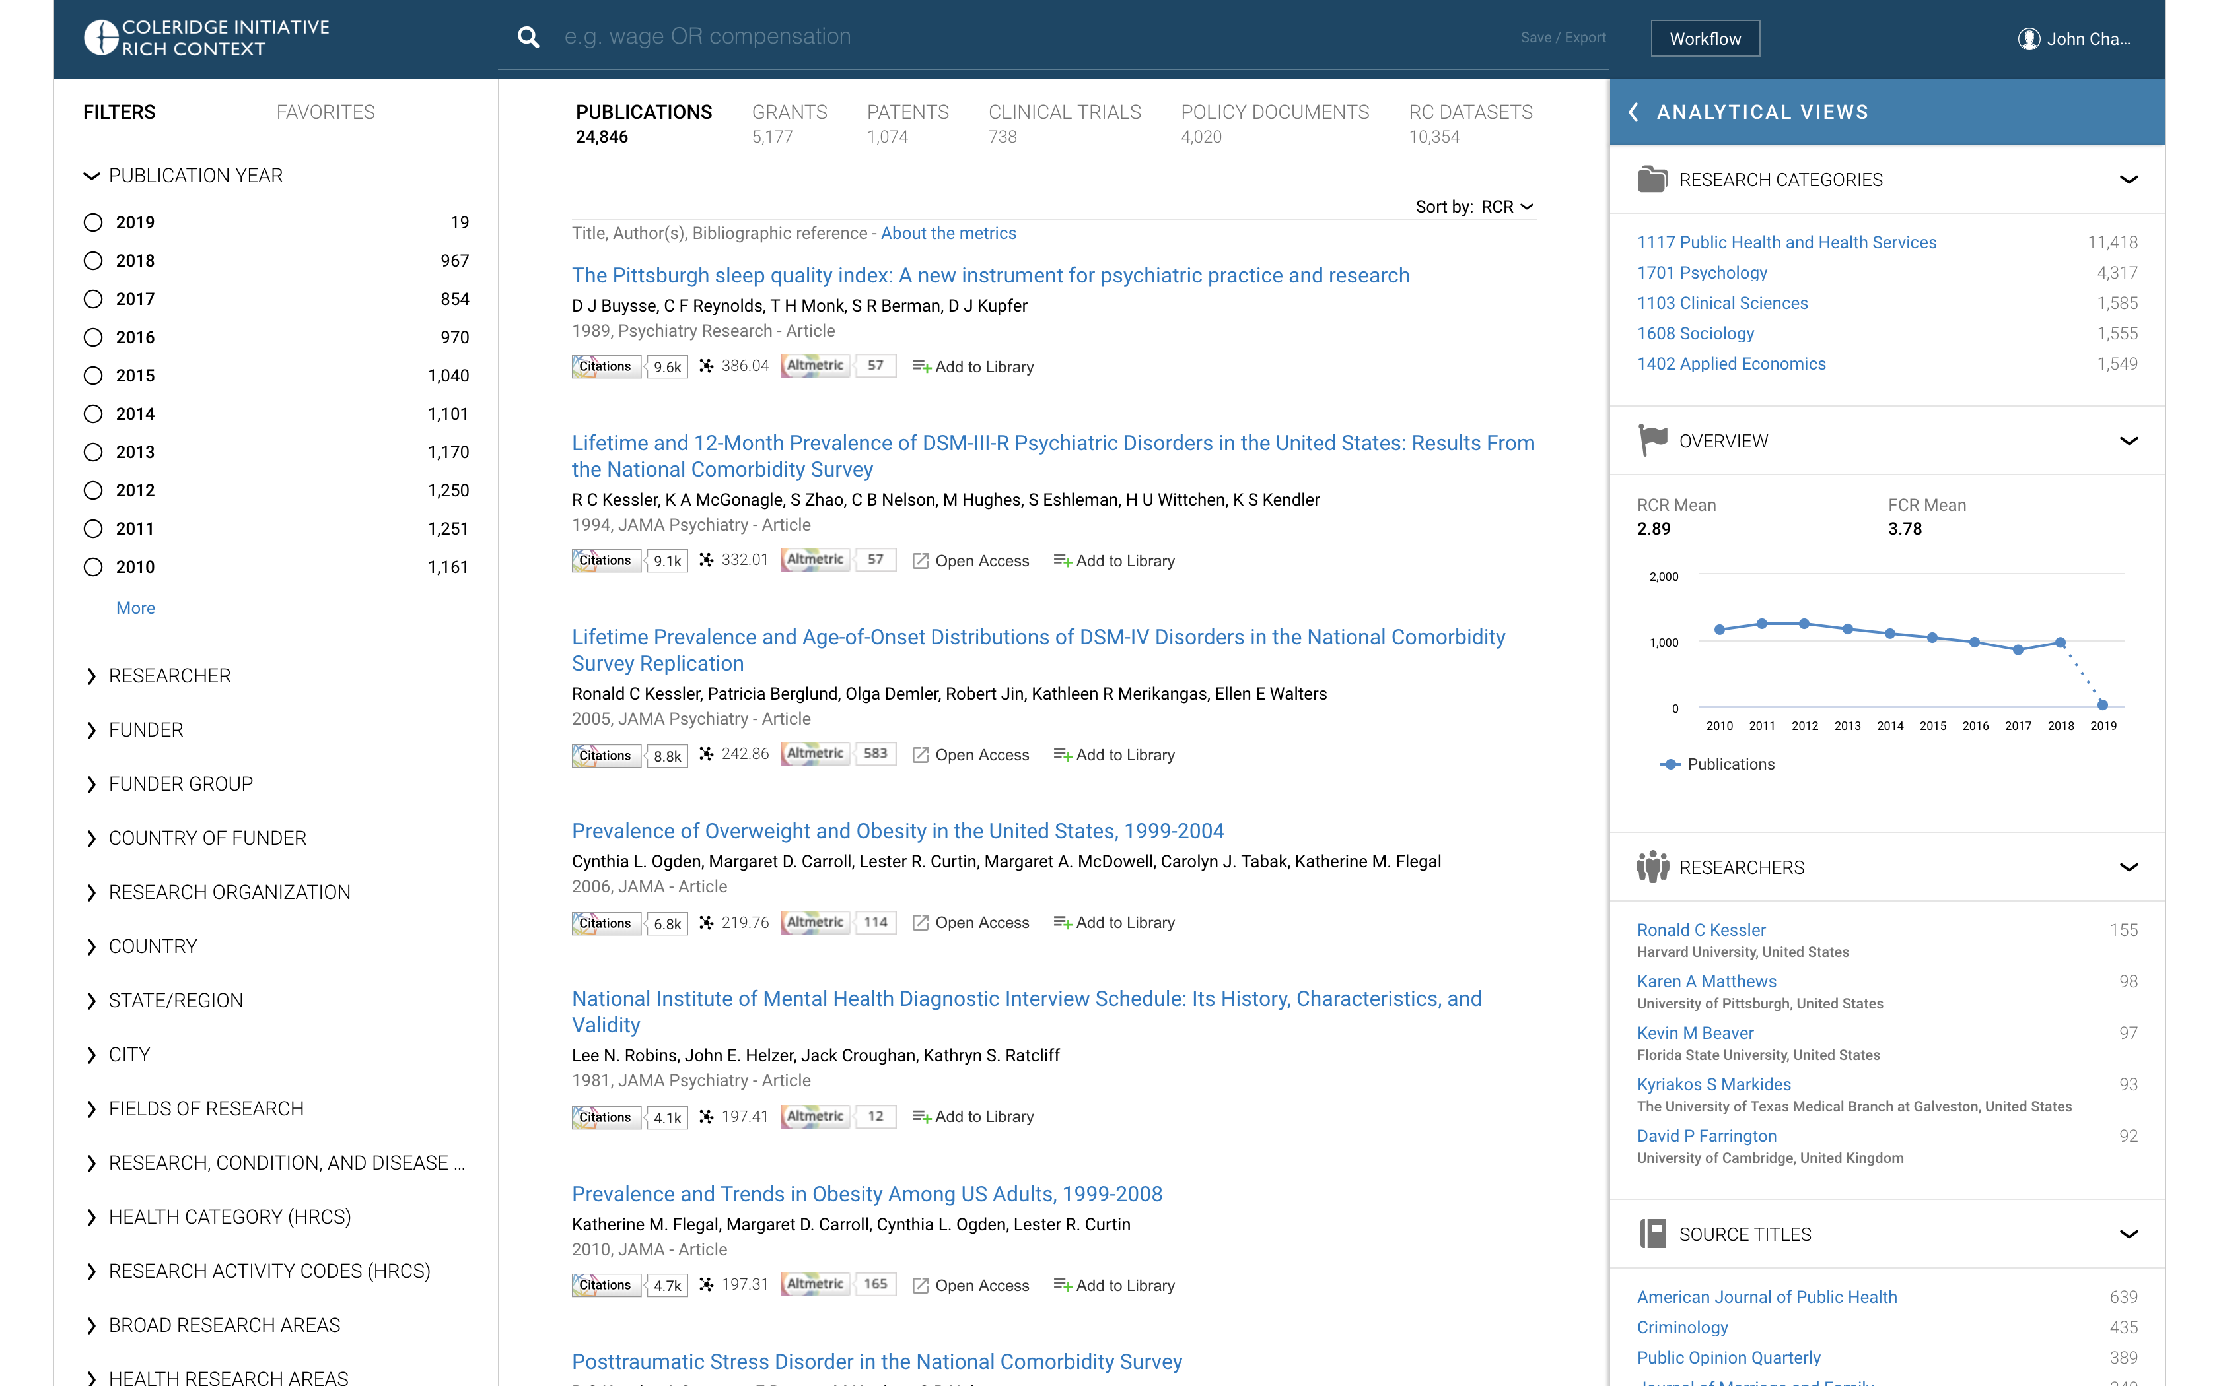
Notes:
Demo landing page. Interface is populated using dataset/publication linkages provided by Julia’s team to DS. Grants, patents, clinical trials, and policy document data identified by DS based on linkages in DS data to the dataset-referencing publications.
Publication <- RC Dataset (from Julia’s team)
Publication <- Grant (funding acknowledgement)
Publication <- Patent (non-patent literature reference)
Publication <- Clinical trial (cited publication)
Publication <- Policy document (cited publication)
https://coleridge.dimensions.ai/discover/publication?order=rcr

Slide 9
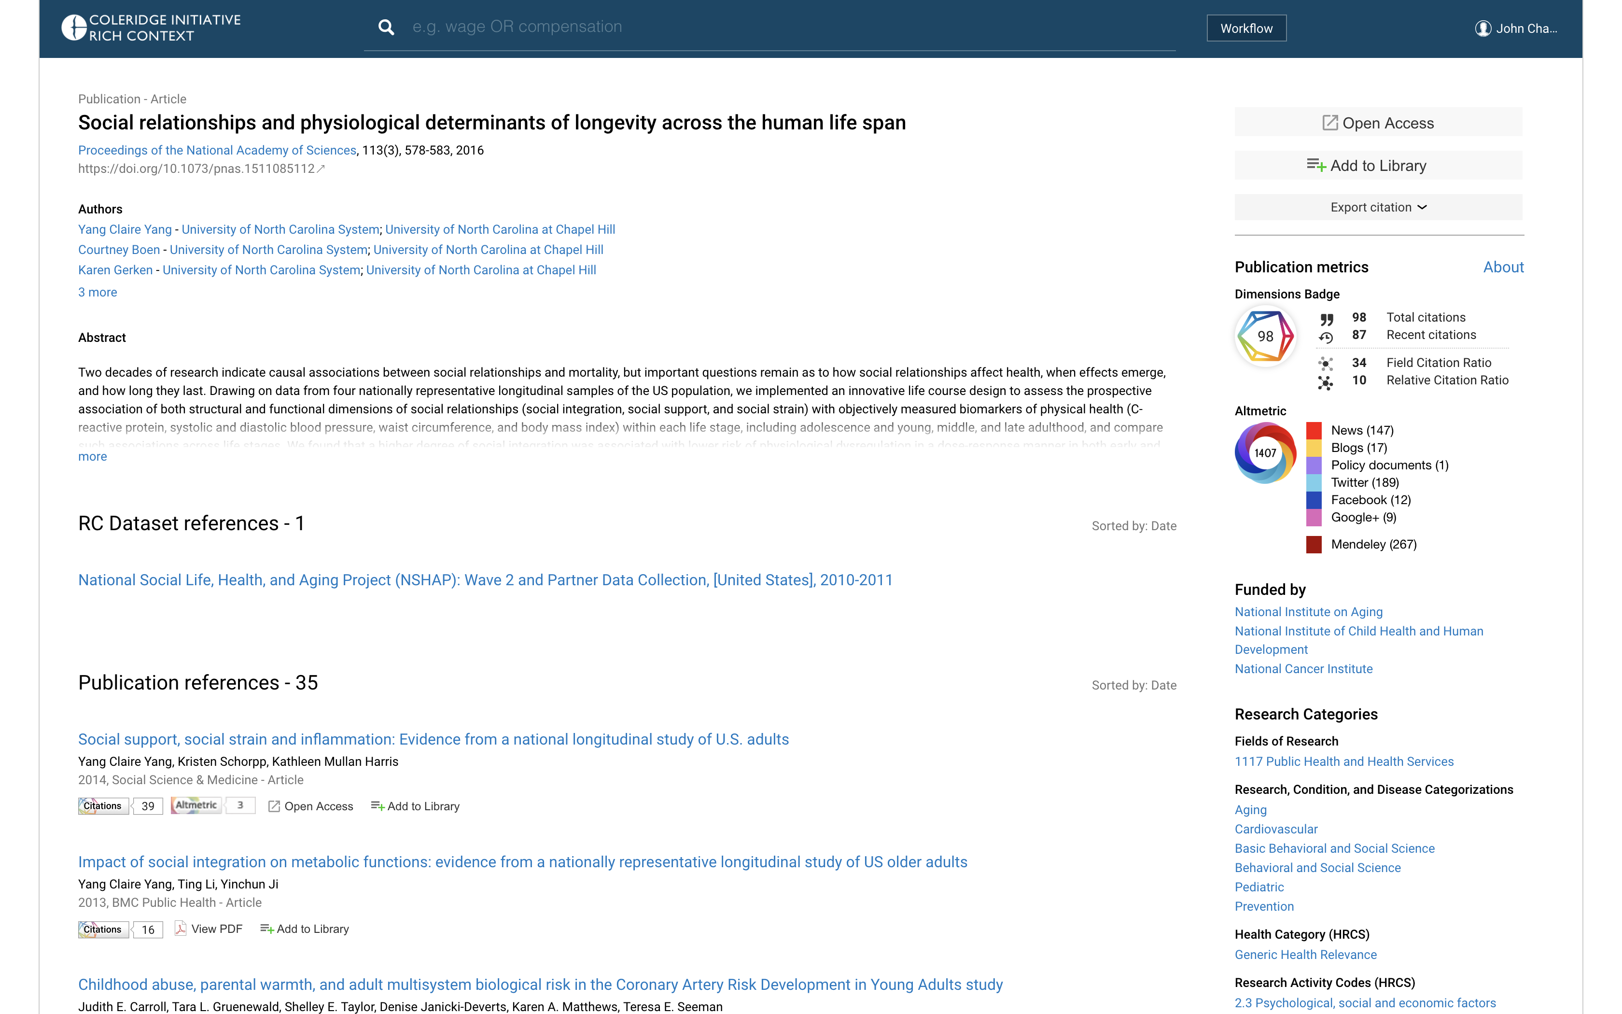
Notes:
Publications details page. Notable features include links to referenced datasets, links to cited publications, links to citing publications, links to supporting grants, links to citing policy documents, citations metrics, altmetrics, and categorization schemes. The data on publications associated with datasets can be aggregated to provide insights such as key researchers with experience working with a dataset or funding organizations with a portfolio of projects that leverage a dataset.
https://coleridge.dimensions.ai/details/publication/pub.1027100825

Slide 10
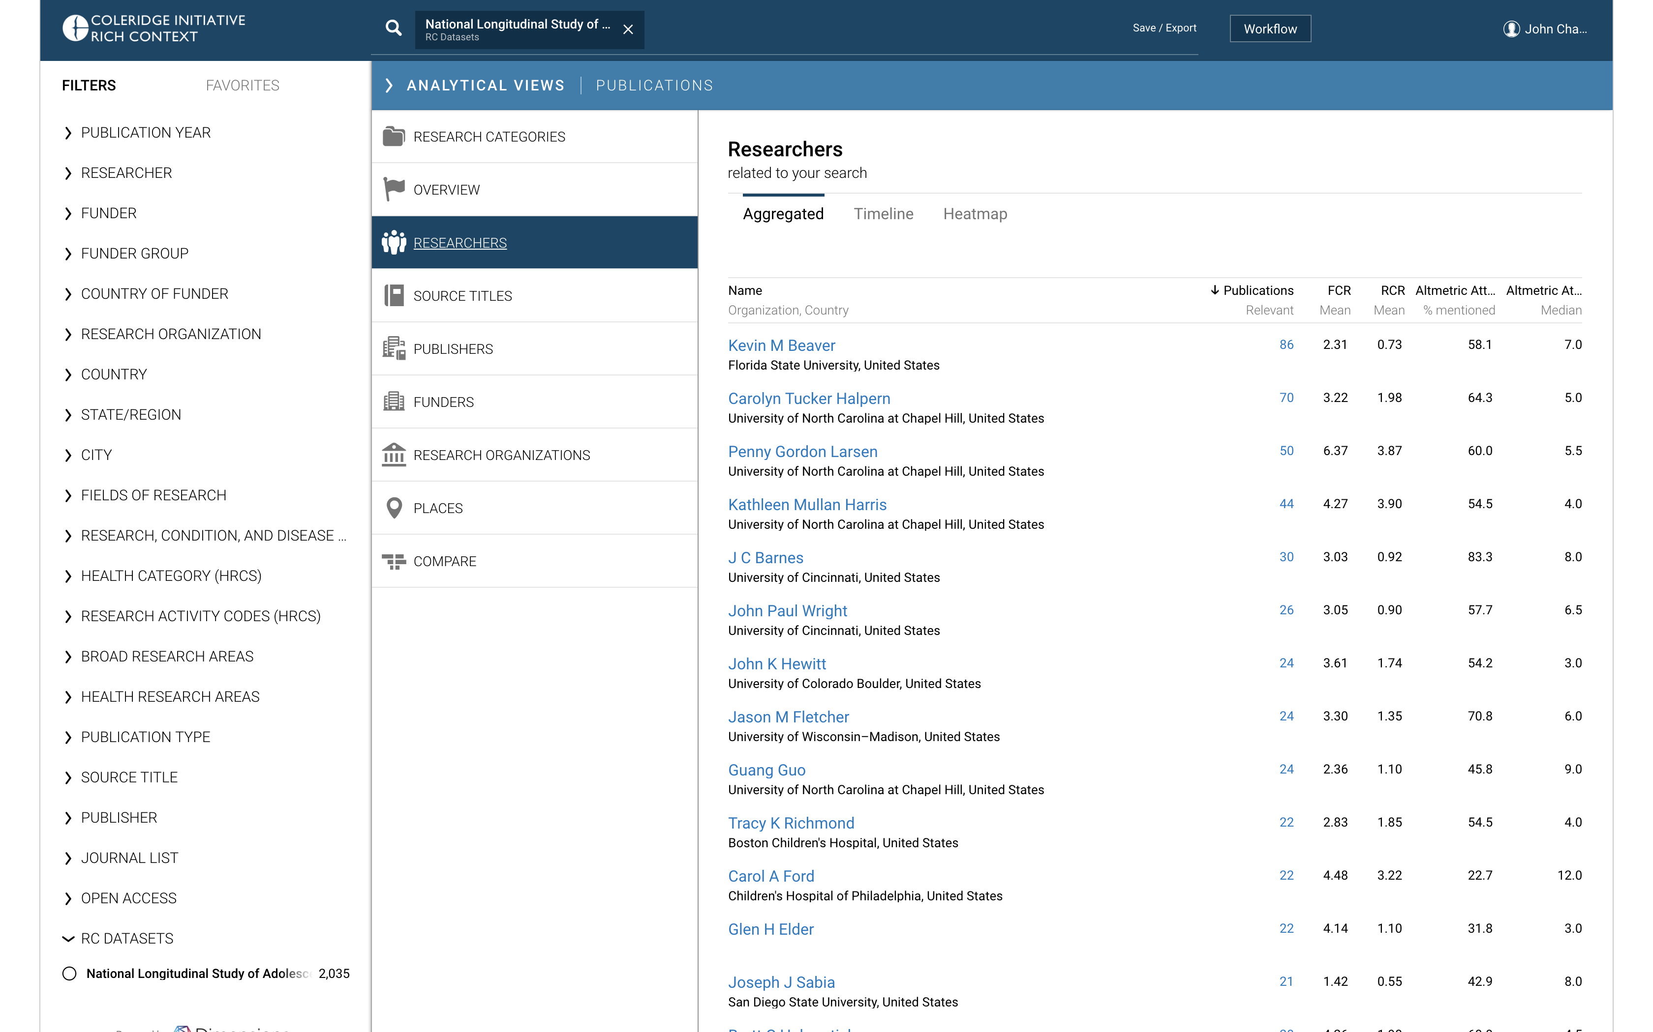
Notes:
'Analytical View’ identifying researchers with experience working with the Add Health dataset.
https://coleridge.dimensions.ai/analytics/publication/author/aggregated?order=rcr&and_facet_rc_datasets=National%20Longitudinal%20Study%20of%20Adolescent%20to%20Adult%20Health%20%28Add%20Health%29%2C%201994-2008%20%5BPublic%20Use%5D

Slide 11
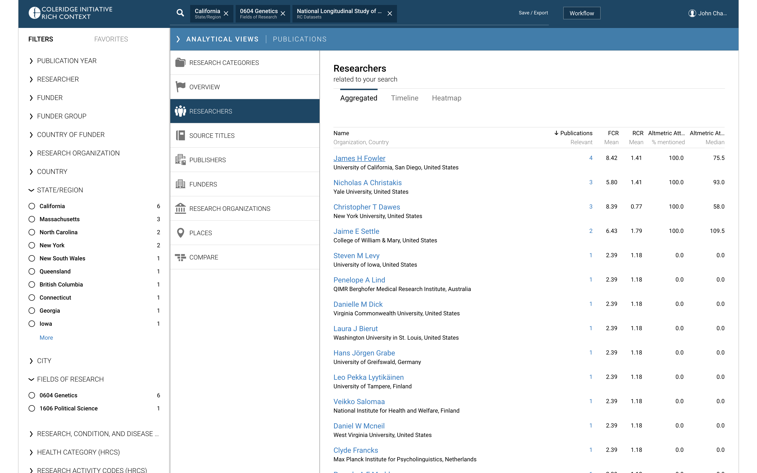
Notes:
Using filters, we can identify researchers with very specific profiles who have experience working with a specific dataset. (Potential collaborators, nearby researchers who can share experience over a cup of coffee… etc)
Here we find researchers in California (or who collaborate with someone in California) who publish ‘Genetics’ papers referencing the Add Health dataset.
https://coleridge.dimensions.ai/analytics/publication/author/aggregated?and_facet_research_org_state=US-CA&and_facet_for=2620&and_facet_rc_datasets=National%20Longitudinal%20Study%20of%20Adolescent%20to%20Adult%20Health%20%28Add%20Health%29%2C%201994-2008%20%5BPublic%20Use%5D

Slide 12
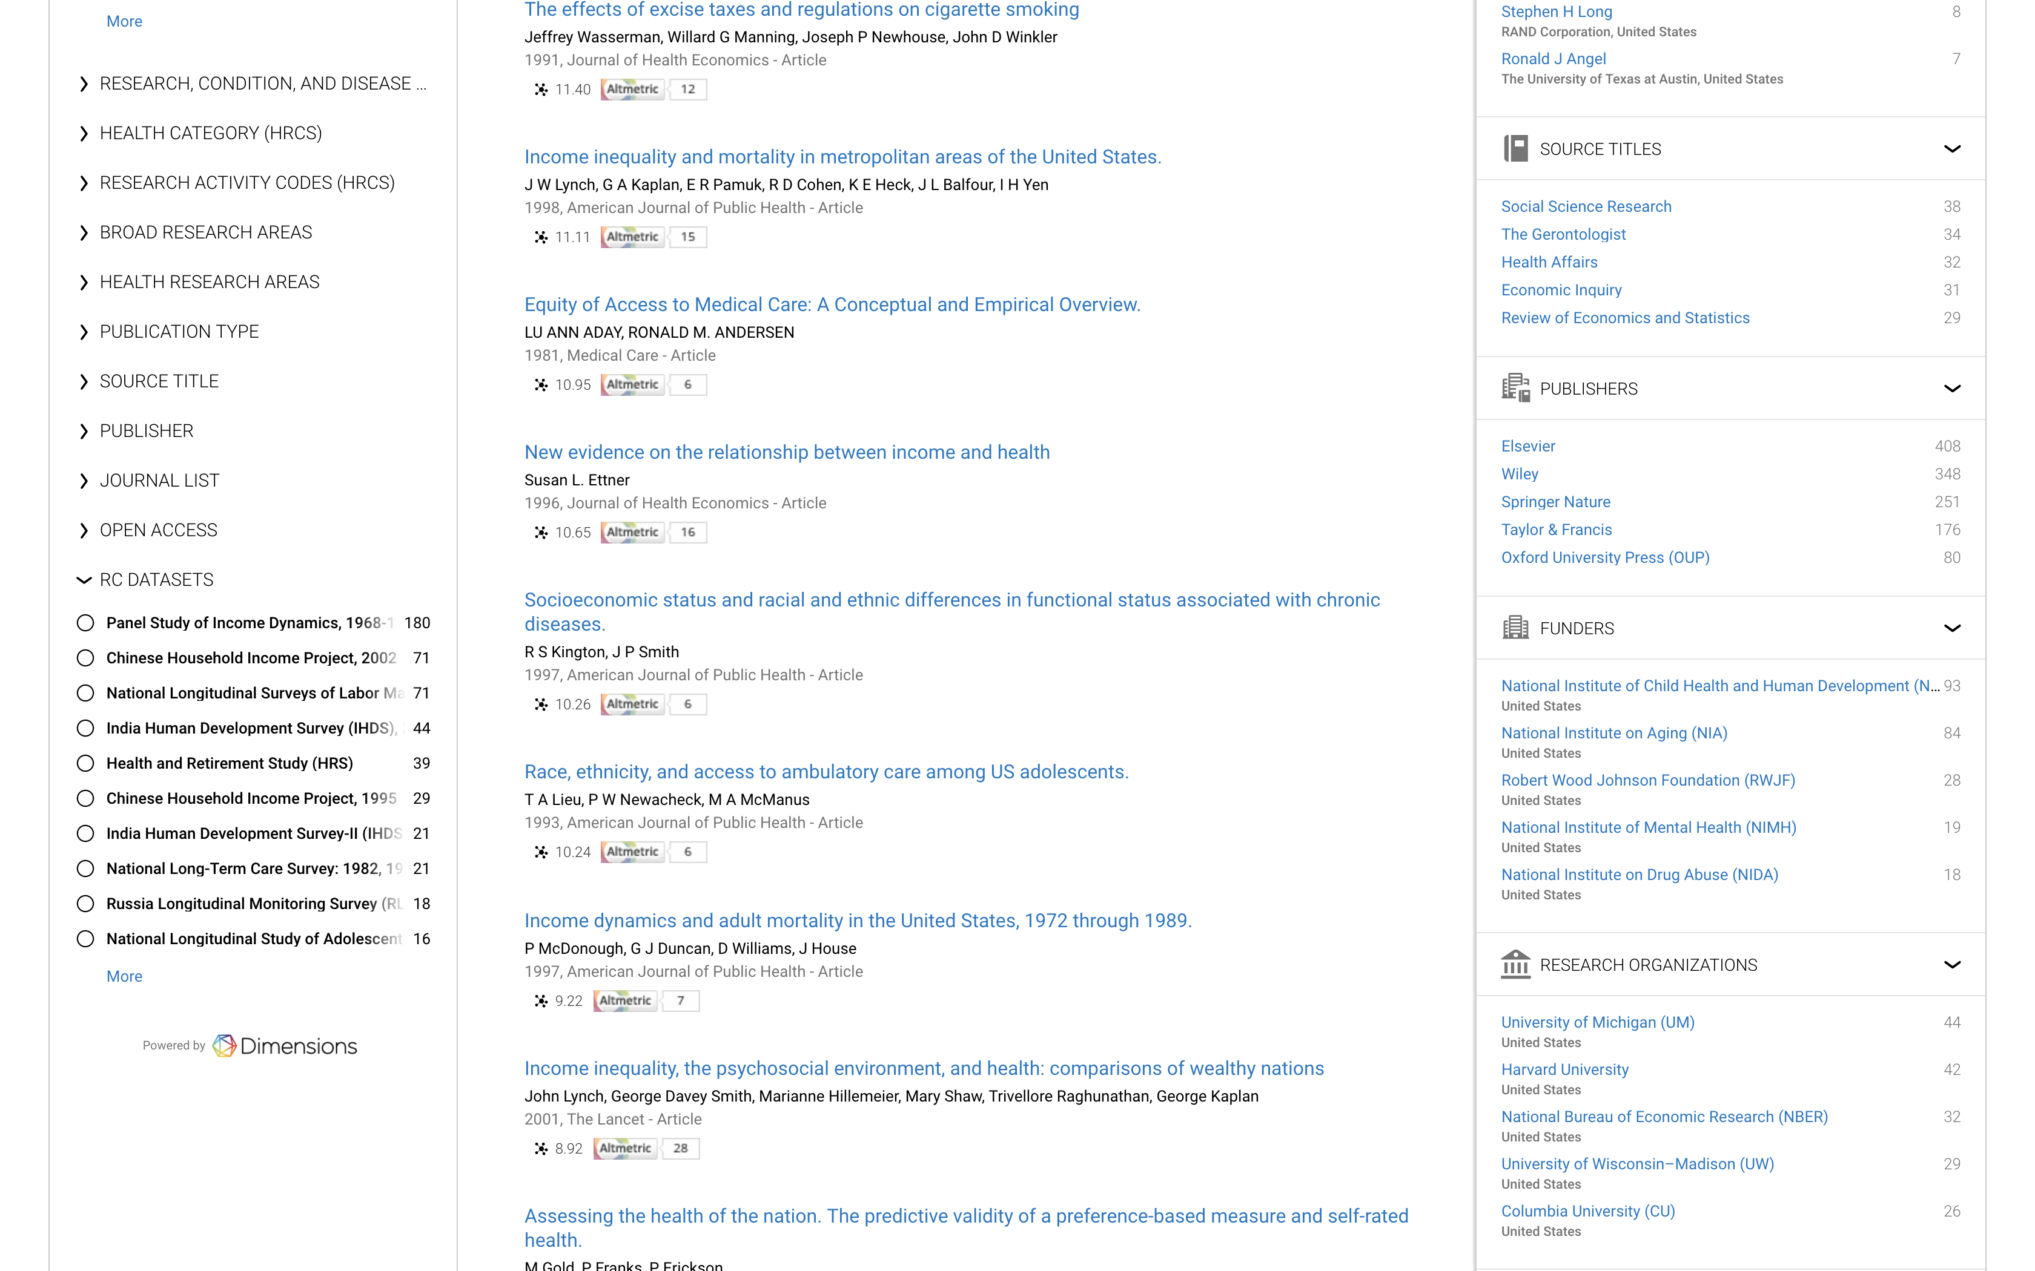
Notes:
What datasets are used for economic research? Here we look at ‘Applied Economics’ publications (using the Fields of Research category system) and identify the top datasets.
https://coleridge.dimensions.ai/discover/publication?order=rcr&and_facet_for=3292

Slide 13
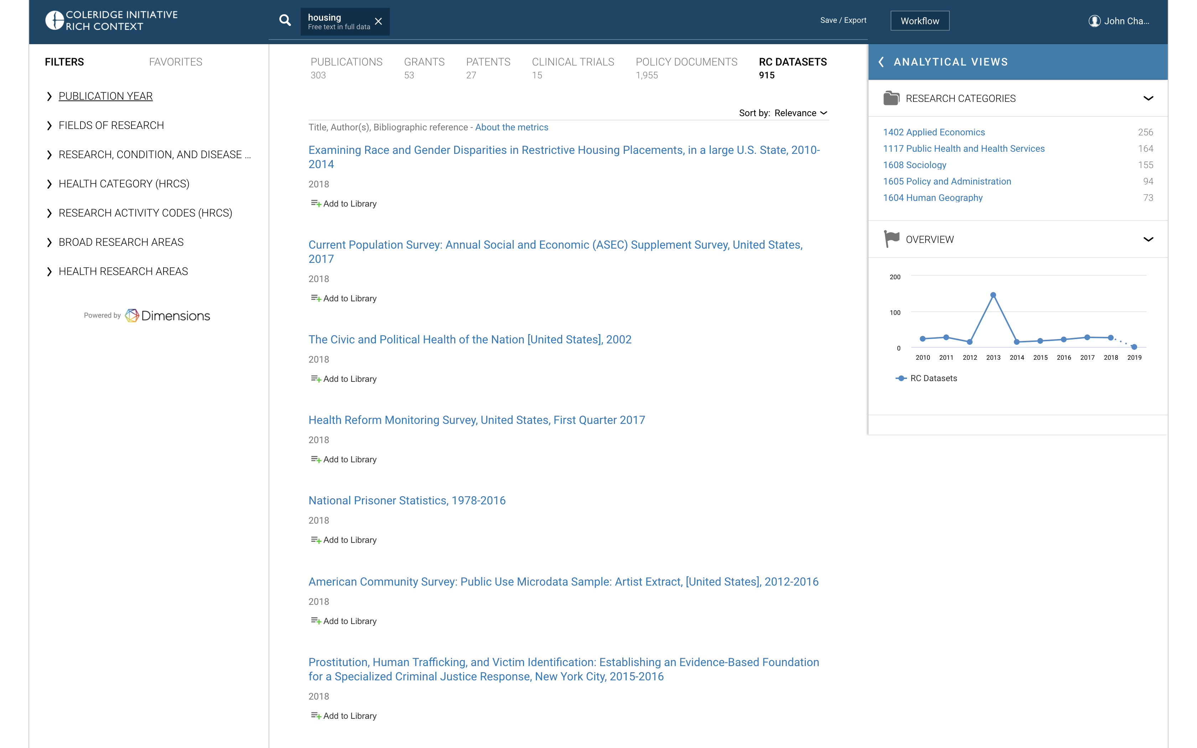
Notes:
Dataset search. What datasets mention ‘housing’ in their description?
https://coleridge.dimensions.ai/discover/dataset?search_text=housing&search_type=kws&search_field=full_search&order=relevance

